Slide 1
Biostatistics Case Studies 2018
Session 2
Overview of Study Designs
Youngju Pak, PhD.
Biostatistician
ypak@labiomed.org

Slide 2
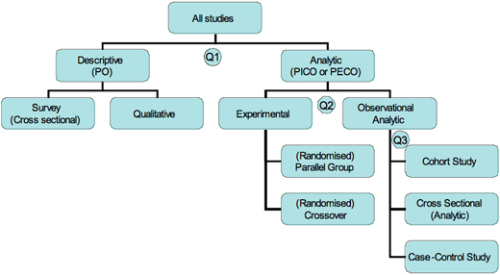
Study Design Tree
(source: Jeremy Howick, www.cebm.net/study-designs)
Notes:
P:Population
O:outcome
I:Intervention
E:Exposure
C:Comparison
Descriptive studies include case reports, case-series, qualitative studies and surveys (cross-sectional) studies, which measure the frequency of several factors, and hence the size of the problem. They may sometimes also include analytic work

Slide 3
What is the aim of the study?
Descriptive (Non-analytic) Study
No specific hypothesis to test
Interested in prevalence, incidence, or exposure
Includes case reports, case-series, surveys, etc
e.g., CDC and prevention Morbidity and Mortality Week Reports(MMWR) of Pneumocystis pneumonia in previously healthy, homosexual men (LA,1981) (http://www.cdc.gov/mmwr/preview/mmwrhtml/jun
Analytic Study
Quantitative hypotheses
Interventions or exposure vs. outcomes
Observational or Experimental

Slide 4
If analytic, how the intervention or the treatment allocated?
Random allocation
→ Experimental or Randomized Control study
Random allocation not possible
→ Observational study
How to obtain the data?
Obtain exposure first, then outcomes later → Prospective
Obtain outcomes first (case or control) and exposure was obtained later based on the recall
→ Retrospective (case-control study)
Both at the same time (or time period)
→ Cross-sectional

Slide 5
Distinguishing different studies
(Source: K. Levin(Evidence-Based Dentistry (2006) 7, 24–25. doi:10.1038/sj.ebd.6400375)

Slide 6
Cross-sectional study
Single time point studies that define a population at a specific time point, may unsuitable for rare disease
Prevalence or Incidence
eg., National Health and Nutrition Examination Survey on overweight and obesity in US.
Cheap & Simple
Ethically Safe
Establish associations at most, not causality
Confounders not controlled
Selected survival bias in estimating prevalence or incidence (aka Neyman bias)
Notes:
Prevalence-incidence bias (also called Neyman bias). Especially in the case of longer-lasting diseases, any risk factor that results in death will be under-represented among those with the disease.
e.g., The study reported a 26 percent reduction in mortality and hospital readmission associated with inhaled corticosteroids use. However, the benefit may have been overestimated because of survival bias. The higher event rate, likely driven by rehospitalization in the early period following discharge, may have forced a majority of the early events to be classified into the nonuser group, because most of these subjects have not yet had an opportunity to receive the medication.

Slide 7
Case Control Study
Quick and cheap;
Only feasible method for very RARE outcome or those with long lag between exposure and outcome;
Fewer subjects needed than cross-sectional studies.
Reliance on recall or records to determine exposure status;
No control of confounders
Selection of control groups is difficult;
Potential bias: recall, selection.
Both cross sectional and case control studies are suitable for generating hypotheses.
Only Odds ratio can be used

Slide 8
Prospective Cohort Study
Better for establishing causality
Provide information on a wide range of disease outcomes
Good for RARE exposure
Reduced recall or selection bias compared with a case control study
For rare disease, large sample sizes or long follow-up necessary
If long follow up time,
Lost to follow up → selection bias
Difficult to maintain consistency of measurements & outcomes over time.
Subject behavior can changes
The aetiology of disease may change
Relative Risk can be indirectly measured.

Slide 9
Randomized Controlled Study
Clinical trials, animal studies in labs
More control of confounders.
Expensive
Randomizations of Treatment
Simple, Stratified, Block, Cluster randomizations
Randomization/ Experimental units
Parallel or Cross-over design
Fixed vs. Sequential design
Intent-To-Treat(ITT) vs. per protocol analyses.

Slide 10
Matched Case-Control study
Notes:
Population attributable risk (PAR): PAR is the portion of the incidence of a disease in the population (exposed and nonexposed) that is due to exposure.

Slide 11
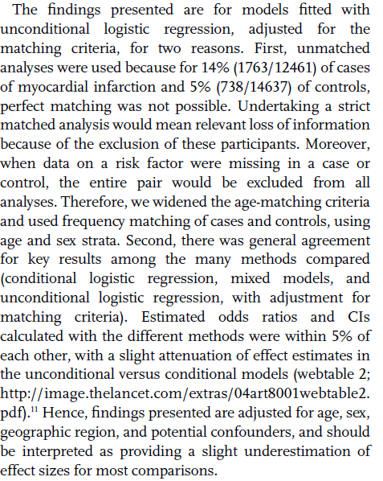
Method & Statistical Analysis

Slide 12
Matching in a case-control study?
Why?
To eliminate confounding effects
How?
One to One matching: best but hard to find
Frequency matching: more practical but weaken the degree of “matching”
Post Analysis?
Consider matched case & control as a pair to maximize the data efficiency → better power
When compare proportion between the two exposure group, use McNemar’s test instead of a Chi-square
For multivariate analysis, use a conditional logistic instead of a conventional logistic model
Not always the case as found in the Yusuf’s study

Slide 13
Main Findings

Slide 14
How to make a better Case-Control study?
Cases
Represents all patients who developed disease
Standardized selection criteria from well defined population
Can be NESTED in a larger cohort
Where?
Case registries
Admission records
Pathology logs
High participation rate
Controls
Represent “healthy” population without disease
No perfect control group exists
Standardized selection criteria from well defined population
Where?
General population
Neighborhood
Families
Hospitals

Slide 15
How to make a better Case-Control study?
All observation made using the same methods for cases & controls (consistency)
To avoid selection bias → the same hospital or family control
Avoid interviewer or recall bias → standardize data collection methods, train the interviewers
Consider cost & accessibility
To minimize confounding → Matched controls for age, sex, or other risk factors that are NOT interests of the study

Slide 16
Nested Case Control Study

Slide 17
Nested Case-Control studies
Select from prospective cohort study
eg., Stored samples
Use baseline and follow up samples and data
from newly occurring cases
Compare to matched or unmatched controls
Efficient for expensive/difficult to measure
Helps avoid selection and data collection biases
Need to have enough cases in the cohort
Need to store all the samples and data

Slide 19
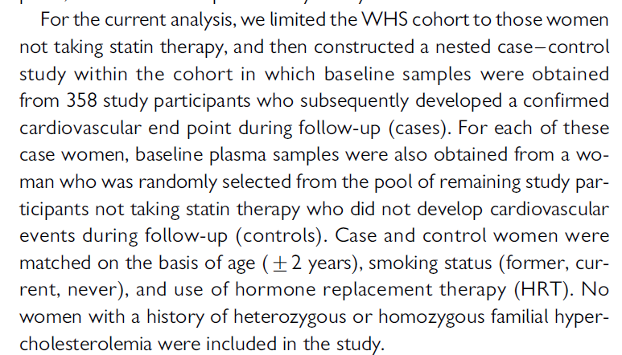
Method continue..

Slide 20
Statistical Analysis

Slide 21
Review points
Where case & control are obtained? Are they consistent ?
How were cases & controls defined?
Selection criteria?
Exclusion criteria? Why?
Any potential bias?
Minimize potential confounding?

Slide 22
Concurrent vs. Non-concurrent Prospective Cohort
Concurrent
Defined population is surveyed.
Identify group with supposed risk factor
Identify similar group without risk factor
Follow them forward in time
Compare incidence rates between groups
Non-Concurrent
Define population with presence/absence of exposure ascertained in accurate, objective fashion in the PAST
Retrospective study since it is based on historical data
Surveyed in present: disease occurrence
Define incidence rates and compare between the two groups

Slide 23
How to make a better Prospective Cohort study
Exposed and non-exposed should be representative and well defined.
Non-exposed status should be maintained during the study period
Disease outcomes should be well defined prior to study and no changes during the study period
Standard criteria applied to both exposed and non-exposed.
Minimize loss to follow-up (>80%)

Slide 24
Spotting the Study Design
Q1. What was the aim of the study?
To simply describe a population (PO questions)
implies descriptive
To estimate/test the relationship between factors
(PICO questions) implies analytic.
Q2. If analytic, was the intervention randomly allocated?
Yes? Implies RCT
No? implies Observational study
For observational study the main types will then depend on the timing of the measurement of outcome, so our third question is:
(source: Jeremy Howick, www.cebm.net/study-designs)

Slide 25
Spotting the Study Design
Q3. When were the outcomes determined ?
Some time after the exposure or intervention?
-> Implies cohort study (‘prospective study’)
At the same time as the exposure or intervention?
-> Implies cross sectional study or survey
Before the exposure was determined?
-> implies case-control study (‘retrospective study’
based on recall of the exposure)
(source: Jeremy Howick, www.cebm.net/study-designs)

