Slide 1

Biostatistics Case Studies 2018
Understanding hypothesis testing,
P values, and sample size determination.
Youngju Pak, PhD.
Biostatistician
ypak@labiomed.org

Slide 2
Overview of biostatistical supports
Biostatistics consulting services available to LABioMed investigators:
Assistance with study design and protocol development
Developing Data Analysis Plans
Power and sample size calculation
Creating randomization schedules
Guidance in data analysis and interpretation of results
Advice on statistical methods and use of statistical software
Discussion with journal club presenters on statistical aspects of the article

Slide 3
Announcements
All lecture materials will be uploaded in the following website
research.labiomed.org/biostat → statistics Education → Courses→ Biostatistics Case studies 2017
Try to read posted articles before the class you can and pay more attention to statistical components when you read them
Send me an e-mail (ypak@labiomed.org) so I can communicate with you if necessary.

Slide 4
Five stages when carrying out a hypothesis test
Define the null (H₀) and alternative(Ha) hypothesis under the study.
Collect relevant data from a sample of individuals.
Calculate the value of the test statistics specific to the null hypothesis
Compute the P-value by compare the value of the test statistics to values from a known probability distribution
Interpret the P-value and results

Slide 5
A criminal prosecution in U.S. justice system
Define the null (H₀) and alternative(Ha) hypothesis under the study : a primary suspect is arrested and assumed to be “Not Guilty” (H₀) until proven, H_{a} to be “Guilty”
Collect relevant data from a sample of individuals: works from a prosecutor to find the evidence to prove against“ Not Guilty (H₀)
Calculate the value of the test statistics specific to the null hypothesis : a prosecutor aggregate all possible evidences/witness statements to make “Not Guilty (H₀) ” to be rejected BEYOND a reasonable doubt by jury

Slide 6
A criminal prosecution in U.S. justice system
Compute the P-value by comparing the value of the test statistics to values from a known probability distribution: a jury decide how rare all evidences presented by a prosecutor if a defendant is “Not Guilty”. Is it a beyond reasonable doubt?
Interpret the P-value and results: How RARE what I see from all prosecutor’s evidences if a defendant is “Not Guilty”?

Slide 7
Insignificnat p-values for Inequality tests
Insignificant p-values (> 0.05) usually mean that you don’t find a statistically sufficient evidence to support Ha and this doesn’t necessary mean H₀ is true.
H₀ might or might not be true => Your study is still “INCONCLUSIVE”.
Insignificant p-values do NOT prove your null !

Slide 8
How to interpret P Value , in general ?
A P Value is predicted probability on the assumption that H₀ is true
A P Value measure the degree of “RARENESS” of what your data show if H0 is true.
A P Value is NOT a probability of the alternative being correct.
A P Value should be used as an evidence to DISPROVE H₀, not to prove the Ha. ( Not innocent enough ! Thus we are favor toward the defendant to be GUILTY, but we DO NOT prove the defendant to be GUILTY).

Slide 9

What’s happening in courts is the same as what’s happening in scientific labs.
Type I and Type II error rates !
Not Guilty Guilty
H_{o} is true Ha is true
H₀ is true Ha is true
Type II error rate (β)
Jury’s Action
Do not
reject H_{o}
Reject H_{o}
Power (1-β)
Type I error rate (α)

Slide 10
α , β, statistical power, p-value,
They are all conditional probabilities !
Type I error rate (α) =prob. (reject Ho in favor of Ha when Ho is true)
Type II error rate (β)= prob.( do not reject Ho when Ha is true)
Statistical Power (1- β) =prob.(reject Ho in favor of Ha when Ha is true) α is usually set as 5%. But the statistical power can be different based on different sample size & effect size (=expected treatment effect/ standard deviation). Thus proposed sample size need to be justified based on the statistical power, usually set at least 80% with a reasonable effect size.

Slide 11
Hypothesis test to test Inequality
Two or more treatments are assumed equal (H₀)and the study is designed to find overwhelming evidence of a difference (Superiority and/or Inferiority).
Most common comparative study type.
It is rare to assess only one of superiority or inferiority (“one-sided” statistical tests), unless there is biological impossibility of one of them.
Hypotheses:
  H_{a}: | mean(treatment ) - mean (control ) | ≠ 0
  H₀: | mean(treatment ) - mean (control ) | = 0

Slide 12
Equivalence Study:
Two treatments are assumed to differ (H₀) and the study is designed to find overwhelming evidence that they are equal.
  Usually, the quantity of interest is a measure of biological activity or potency(the amount of drug required to produce an effect) and “treatments” are drugs or lots or batches of drugs.
  AKA, bioequivalence.
  Sometimes used to compare clinical outcomes for two active treatments if neither treatment can be considered standard or accepted. This usually requires LARGE numbers of subjects.

Slide 13
Hypotheses for equivalence tests
H_{a} : mean (trt 1) – mean (trt 2) = 0
  H₀: mean(trt 1) - mean (trt 2 ) ≠ 0
  With a finite sample size, it is very hard to find two group means are exactly the same.
  So we put a tolerability level for the equivalence, AKA, the equivalence margin, usually denoted as Δ
  Practical hypotheses would be
    H_{a} : Δ ₁< mean(trt 1) – mean (trt2) < Δ₂
    H₀ : mean(trt 1) – mean (trt2) ≤ Δ ₁
    or mean(trt 1) – mean (trt2) ≥ Δ₂
Non-inferiority

Slide 14
Today, we are going to learn how to determine sample size for Inequality tests using software using two published studies.

Slide 15
Study #1

Slide 17
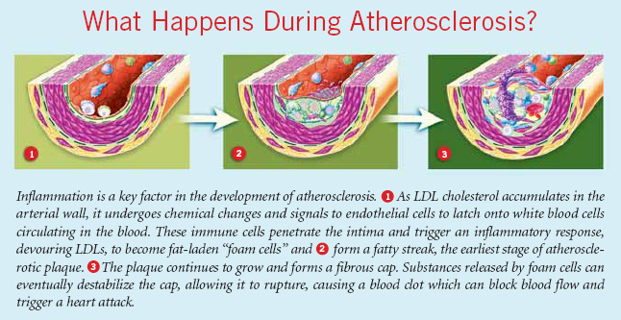
Atherosclerosis

Slide 18

Back to:
How was 498 determined?

Slide 19
From earlier design paper (Russell 2007):
Δ = 0.85(0.05)mm = 0.0425 mm

Slide 20
Need to Increase N for Power
Power is the probability that p<0.05 if Δ is the real effect, incorporating the possibility that the Δ in our sample could be smaller.
2SD²
Δ²
N =
(1.96)²
for 50% power.
Need to increase N to:
2SD²
Δ²
N =
(1.96 + 0.842)²
for 80% power.
2SD²
Δ²
N =
(1.96 + 1.282)²
for 90% power.
from Normal Tables

Slide 21
Info Needed for Study Size: Comparing Means
2SD²
Δ²
N =
(1.96 + 0.842)²
Effect
Subject variability
Type I error (1.96 for α=0.05; 2.58 for α=0.01)
Power (0.842 for 80% power; 1.645 for 95% power)
Δ/SD
= Effect size
Same four quantities, but different formula, if comparing %s, hazard ratios, odds ratios, etc.

Slide 22
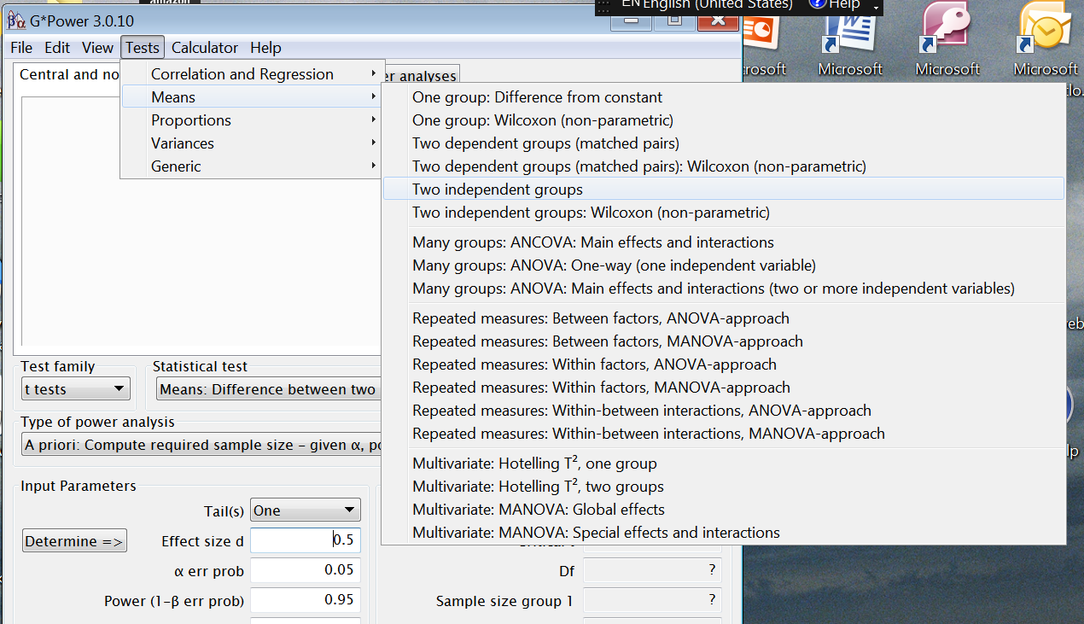
Comparing two independent means
using G*Power 3.0.10
(Free software for power calculations)

Slide 23
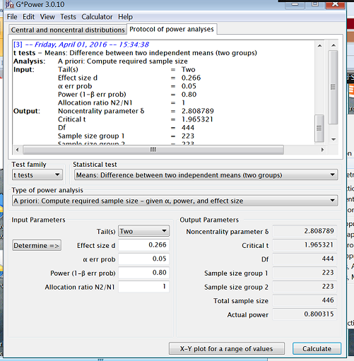
Comparing two independent means using G*Power 3.0.10
(Free software for power calculations)

Slide 24
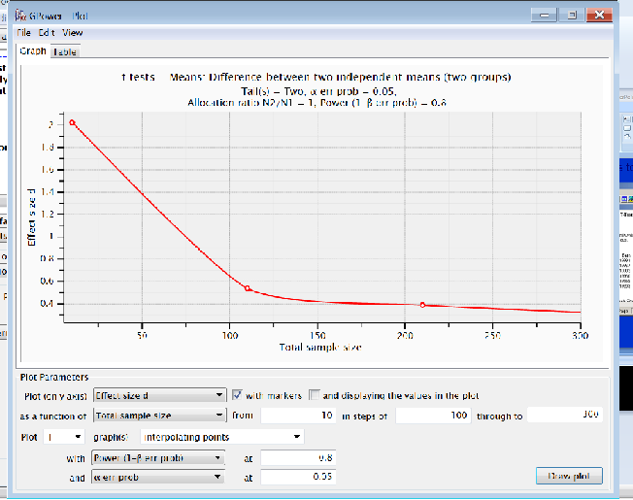
Comparing two independent means using G*Power 3.0.10
(Free software for power calculations)

Slide 25
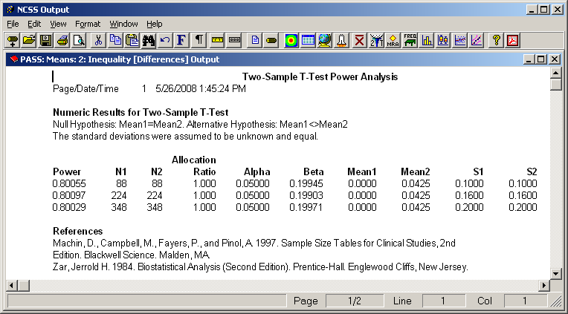
SD Estimate Could be Wrong
Should examine SD as study progresses.
May need to increase N if SD was underestimated.

Slide 26
Study #2

Slide 28
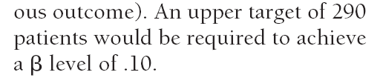
Sample size justification

Slide 29
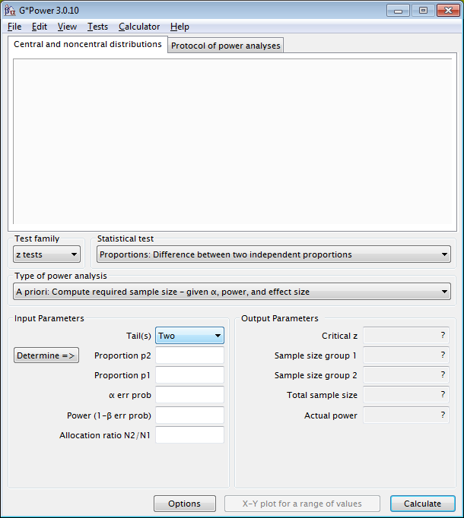
Comparing two independent proportions using G*Power 3

Slide 30
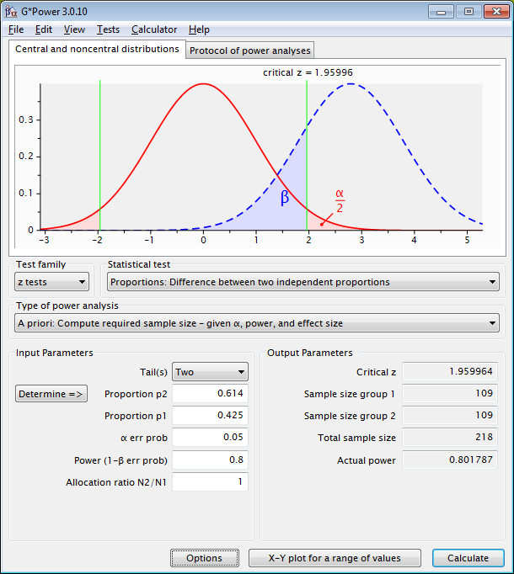
Comparing two independent proportions using G*Power 3

Slide 31
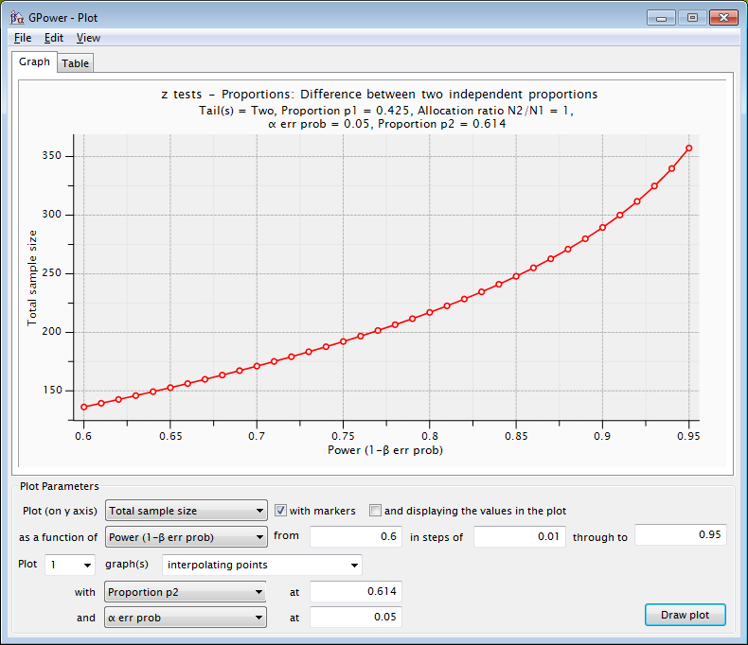
Comparing two independent proportions using G*Power 3
0.189

Slide 32
A statistical power primarily depends on what statistical test to be used. The choice of statistical tests depends the data type of two variables (dependent v.s independent variables).
Dependent variables are outcomes of interest while independent variables are the hypothesized predictors of outcomes.
Independent variables are also called explanatory variables

Slide 33
Types of Data
Variable
Qualitative
Categorical
Numerical
Quantitative
Nominal
Categories are mutually exclusive and unordered
Examples:
Gender, Blood group,
Eye colour,
Marital status
Ordinal
Categories are mutually exclusive and ordered
Examples:
Disease stage,
Education level ,
5 point likert scale
Counts
Integer values
Examples:
Days sick per year,
Number of pregnancies,
Number of hospital visits
Measured
(continuous)
Takes any value in a range of values
Examples:
weight in kg, height in feet, age (in years)
Notes:
33
Many ordinal scales in medicine – numbers frequently used but does not mean equivalence between steps. Also summative or added rating scales are common e.g. IDA (Index of Disease Activity) or Hamilton’s Depression Scale.

Slide 34
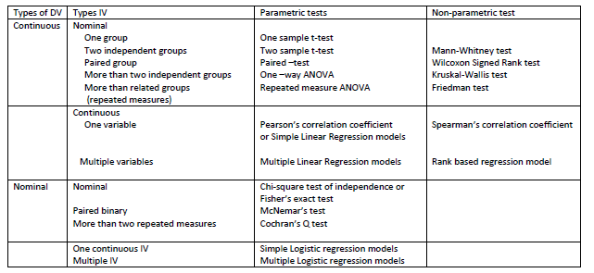
Choosing a statistical test
►DV: Dependent variable, IV: Independent variable, where IV affects DV. For example, treatment is IV and clinical outcome is DV when treatments affect clinical outcomes.

Slide 35
A statistically significant result ---
is not necessarily an important or even interesting result
may not be scientifically interesting or clinically significant.
With large sample sizes, very small differences may turn out to be statistically significant. In such a case, practical implications of any findings must be judged on other than statistical grounds.
Statistical significance does not imply practical significance

Slide 36
Assumptions
Random samples from the population
  Beware of convenience samples
Population is Gaussian (Normal distribution) if sample size is “small” (n<30)
Independent observations
  Beware of double counting or repeated measures

Slide 37
Other Sample Size Software

Slide 38
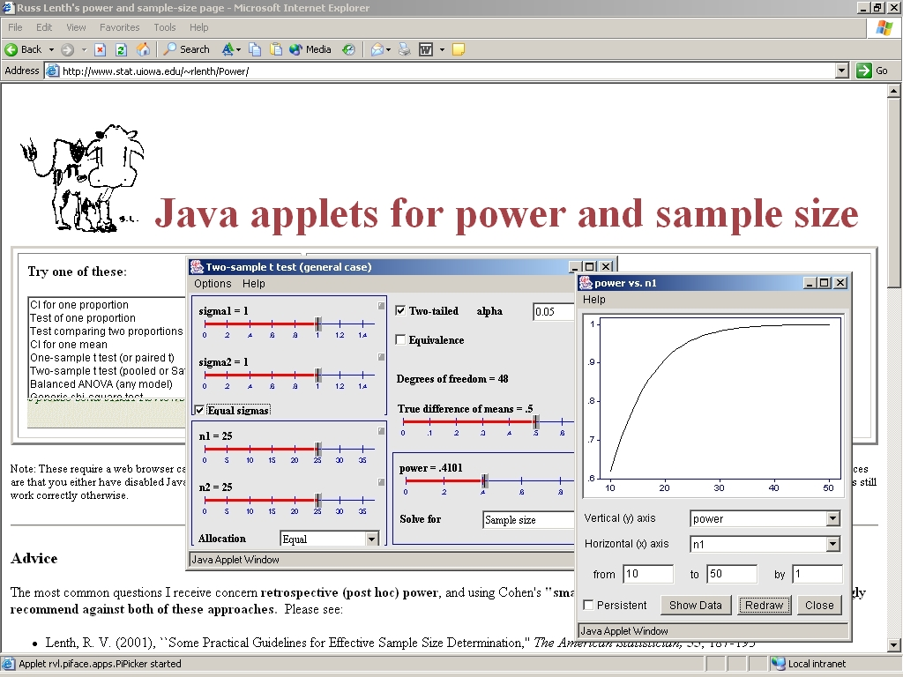
Free Sample Size Software
www.stat.uiowa.edu/~rlenth/Power

Slide 39
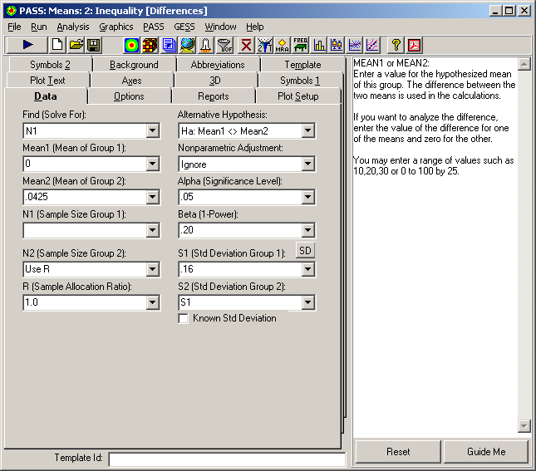
Study Size Software in GCRC Lab
ncss.com ~$500

Slide 40
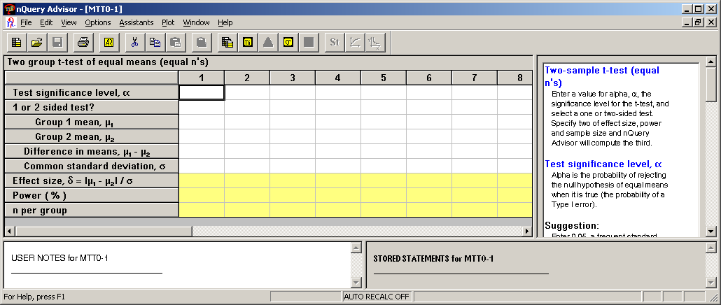
nQuery - Used by Most Drug Companies

