Slide 1
REDCap: Research Electronic Data Capture
A secure, web-based application
for building and managing online surveys and databases
Liz Chen, MBA
Informatics Core Manager
UCLA Clinical and Translational Science Institute
@Harbor-UCLA Medical Center and
Los Angeles Biomedical Research Institute

Slide 2
What’s REDCap
REDCap is a mature, secure web application for building and managing online surveys and databases.
Designed specifically to support biomedical/clinical research studies.
Supports data entry from case report forms, as well as deployment of online surveys. Using REDCap's stream-lined process for rapidly developing projects, you may create and design projects using 1) the online method from your web browser using the Online Designer; and/or 2) the offline method by constructing a 'data dictionary' template file in Microsoft Excel, which can be later uploaded into REDCap.
Provides export procedures for seamless data downloads to Excel and common statistical packages (SPSS, SAS, Stata, R)
No programming or web development experience needed. User-friendly interfaces for building forms, structuring databases, entering data, and developing queries.

Slide 3
REDCap Features
Fast Setup - Build databases quickly and easily.
Secure and web-based - Input data from anywhere in the world with secure web authentication
Multi-site access - Support studies involving researchers from multiple sites and institutions.
Flexible - Fully customizable. You are in total control of shaping your database.
Mid-study modifications - Modify the database at any time during the course of the study.
Easy in - Data may be imported from external data sources to begin a study or to provide mid-study data uploads.
Easy out - Export data to common data analysis packages - Exports raw data and syntax files for SAS, Stata, R, and SPSS for analysis
Audit trails - Track data access and data manipulation.
User rights -Define member-specific permissions for the research team.

Slide 4
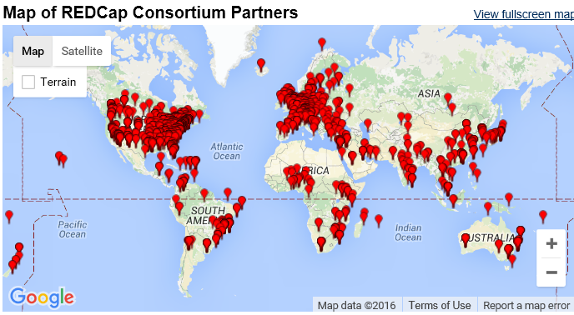
REDCap Project and REDCap Consortium
The REDCap Consortium is composed of 2496 active institutional partners in 115 countries who utilize and support REDCap in various ways.
The REDCap application allows users to build and manage online surveys and databases quickly and securely, and is currently in production use or development build-status for more than 450,000 projects with over 590,000 users spanning numerous research focus areas across the consortium. http://www.project-redcap.org/

Slide 5
REDCap at LABiomed
2006: REDCap Consortium formed, we are one of the first 10 Consortiums
2008: First REDCap Project went live.
Server hosted by CTSI at Harbor UCLA and LABiomed
- Contact: Liz Chen (lchen@labiomed.org) - Available to all researchers with project approved by IRB. - Website: https://research.labiomed.org/redcap
Use of REDCap should be cited in any publications or presentations arising from research projects that make use of the application.
http://ctsi.ucla.edu/pages/cite

Slide 6
How to request redcap access

Slide 7
REDCap Workflow
Step 1 Request
Submit IRB Application (Select use CTSI, Informatics)
Step 2 Development
Design Form
Enter test data
Step 3 Production
Move to production (IRB approved)
Start data collection
Export test
Submit REDCap request https://research.labiomed.org/redcap/surveys/?s=nEcpxr

Slide 8
REDCap Request
Complete access request form to register:
https://research.labiomed.org/redcap/surveys/?s=nEcpxr
Once approved, log in using AD username and password.
Things to consider:
Is the project longitudinal (data collection forms to be administered at multiple time points)?
Does it include Survey?
2) IRB approved?
3) Have you done all the following in your IRB application?
-select "CTSI" as one of the review boards -select "Yes" in question: "Are you going to be using the services of the CTSI?“ -If it's informatics use only, select this is CTSI "core-only" application, then select "informatics".

Slide 9
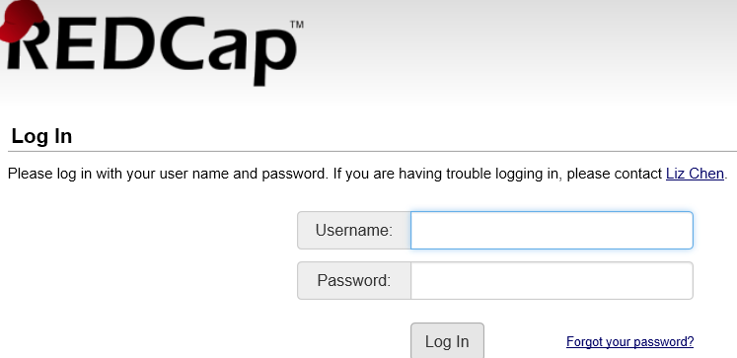
Access REDCap
https://research.labiomed.org/redcap/index.php
Labiomed users: use labiomed email username and password
Non-labiomed users: user Redcap username and password generated by REDCap

Slide 10
Design & modification

Slide 11
Data Collection Forms and Surveys
Build data collection forms using REDCap’s Online Designer.
Or download data dictionary and make modifications.
Forms can be enabled as surveys, Survey link can be emailed to a list of participants.

Slide 12
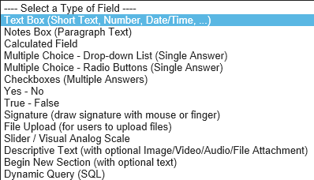
Online Designer – Field Type

Slide 13
Online Designer
Add/Edit Field
Field Label (display on screen)
Variable Name (field name in database, Only letters, numbers, and underscores)
Validation
Required
Identifier
Alignment
Field Note (small reminder text displayed underneath field)
Branch Logic

Slide 14
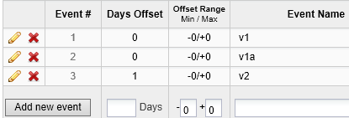
Longitudinal Study (Events)
Define your events

Slide 15
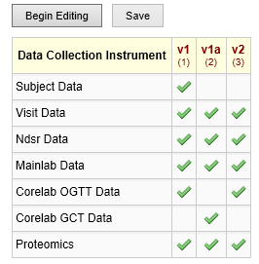
Longitudinal Study (Events and Forms)
Designate Forms for Events

Slide 16
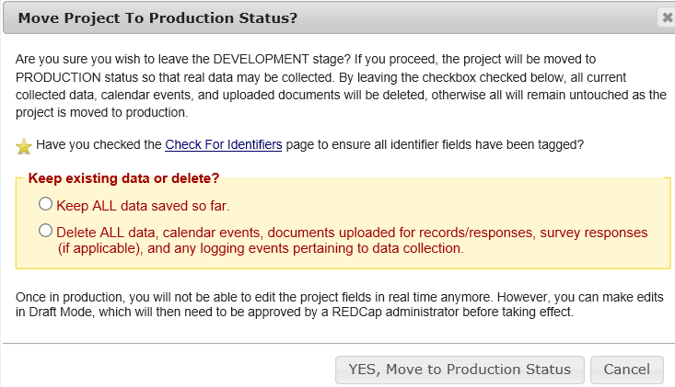
Move to production
Do not start data collection in development mode.
Send request to administrator when ready to move to production indicate keep/delete data before move.

Slide 17
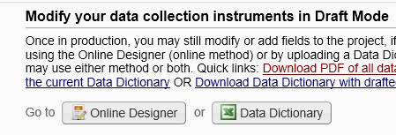
Mid-study modification
Project setup/Online designer
Enter Draft Mode
Submit Changes for Review

Slide 18
Data entry

Slide 19
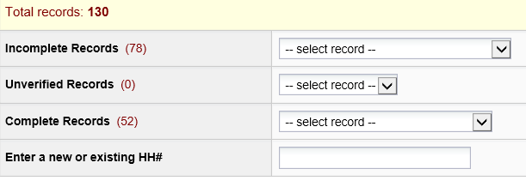
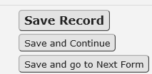
Data Entry
Add/Edit Records

Slide 20
Record Status Dashboard

Slide 21
survey

Slide 22
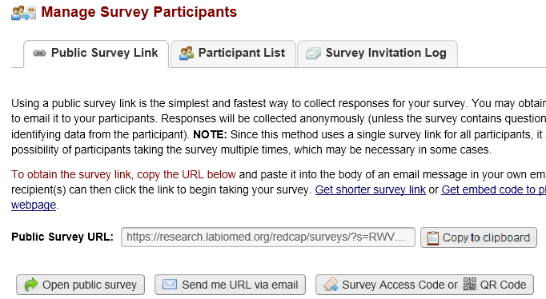
Survey – public URL
Manage Survey Participants
Public survey URL (you can include it in your email)

Slide 23
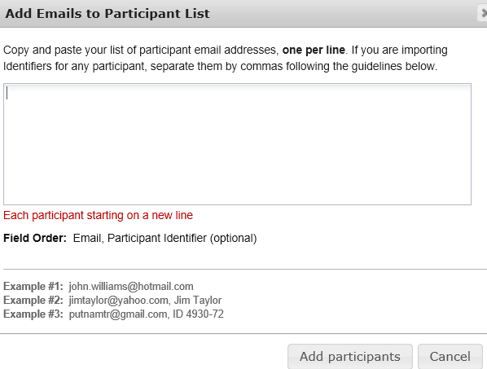
Survey Participant List

Slide 24
Survey – send a invitation

Slide 25
Other functions
Data Export, Report, Import, User, Logging, File Repository

Slide 26
Data Export
Report Builder
Data Export Tools
Graphical Data View & Descriptive Statistics

Slide 27
Report Builder
Step 1
User Access
Step 2
Fields to include in report
Step 3
Filters
Step 4
Order the Results

Slide 28
Data Import Tool
Download your Data Import Template
Place the data for each record in the data import template
Click the 'Browse' or 'Choose File' button below to select the file on your computer, and upload it by clicking the 'Upload File' button.
Once your file has been uploaded, the data will NOT be immediately imported but will be displayed and checked for errors to ensure that all the data is in correct format before it is finally imported into the project.

Slide 29
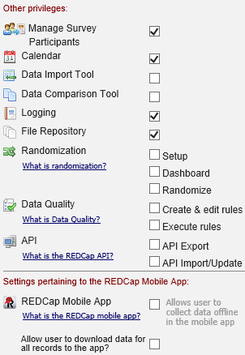
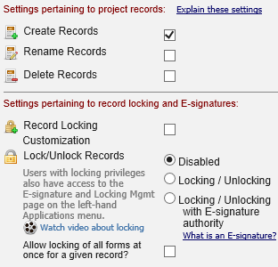
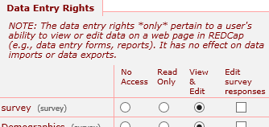
User Rights

Slide 30
Logging (audit trail)

Slide 31
File Repository

Slide 32
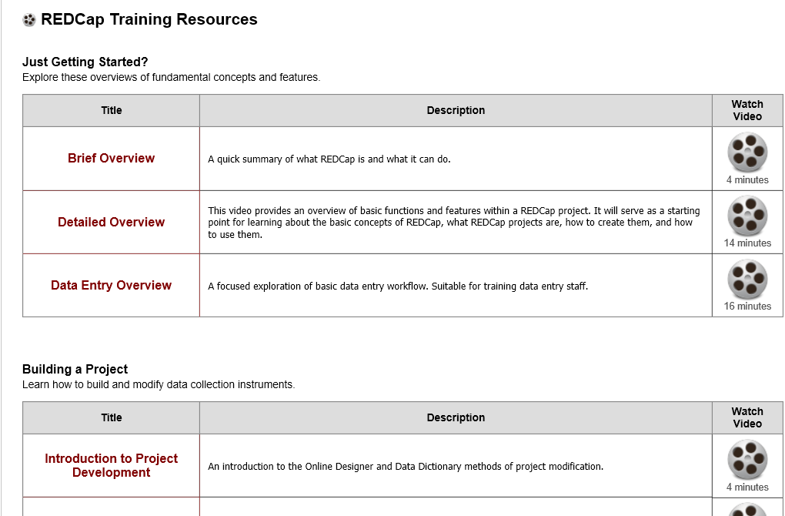
Learn More about REDCap
REDCap provides a library of videos explaining how to use its various modules.
They can be accessed from the user’s home page.
https://research.labiomed.org/redcap/index.php?action=training

Slide 33
Case Study
Publication
http://www.ncbi.nlm.nih.gov/pmc/articles/PMC4422872/
Effectiveness of a smartphone application for weight loss compared with usual care in overweight primary care patients: a randomized, controlled trial.
BACKGROUND:
Many smartphone applications (apps) for weight loss are available, but little is known about their effectiveness.
OBJECTIVE:
To evaluate the effect of introducing primary care patients to a free smartphone app for weight loss.
DESIGN:
Randomized, controlled trial. (ClinicalTrials.gov: NCT01650337).
SETTING:
2 academic primary care clinics.
PATIENTS:
212 primary care patients with body mass index of 25 kg/m2 or greater.
INTERVENTION:
6 months of usual care without (n = 107) or with (n = 105) assistance in downloading the MyFitnessPal app (MyFitnessPal).
MEASUREMENTS:
Weight loss at 6 months (primary outcome) and changes in systolic blood pressure and behaviors, frequency of app use, and satisfaction (secondary outcomes).

Slide 34
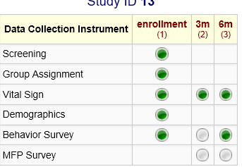
Case Study

Slide 35
Question?
Thank you.

Slide 36
DHS SAGE I2b2

Slide 37
What’s SAGE i2b2
i2b2 (Informatics for Integrating Biology & the Bedside) was designed to support cohort identification, retrospective data analysis, and hypothesis generation. Data is accessed through a web client. The web client is designed with a user-friendly, drag-and-drop interface to enable users to perform data queries without extensive training or technical expertise. I2b2 data is from ORCHID.
SAGE=Systematic Application and Generation of Evidence

Slide 38
Available Data
Diagnoses (ICD9, ICD10 & SNOMED-CT)
Procedures (ICD9, ICD10 & CPT4)
Laboratory Results (LOINC)
Medications (NDC)
Vital Signs
Demographics
Microbiology (SNOMED-CT)
Visit Location
Visit Detail

Slide 39
Limitations
Cerner Millennium Data Only
Refreshed Bi-Weekly
Data Could be Slightly out of Sync (e.g. coding not completed on a case prior to refresh)
Not every single field in Cerner is mapped (information in note is not available)

Slide 40
Understanding data de-identification
Dates shifted +/- 5 weeks
Shifted by 7 days (e.g. admit date on a Wednesday will be in S.A.G.E on a Wednesday)
All ages over 89 are aggregated into a single category of age 90 or older.

Slide 42
I2b2 weblink and training
https://i2b2.cernerresearch.com/webclient/
I2b2 Training video available on DHS intranet:
http://myladhs.lacounty.gov/harbor/orchid/sitepages/sage.aspx

Slide 43
