Slide 1

How to interpret
Bayesian Analysis Results?
Youngju Pak, PhD.
Biostatistician
ypak@labiomed.org

Slide 2
Published Study

Slide 3
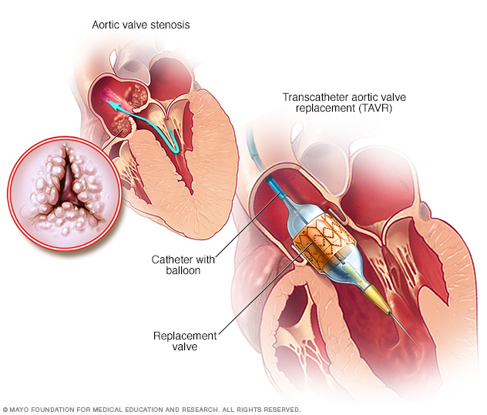
Background
Artic stenosis : a condition that one of the valves in the heart is narrowed enough to impede appropriate blood flow.
Aortic stenosis is especially common in the elderly, a majority of whom are not candidates for surgical replacement of a new aortic valve due to an increased risk of death during surgery.
Transcatheter Aortic Valve Replacement (TAVR): A catheter is placed in an artery near the groin and, being led by a short wire, the new valve is pushed up towards the heart. The valve is placed in the aorta over the old valve, and uses a mechanism to expand and stay. In this way, doctors are performing procedures on patients who may be too weak for open-heart surgery.

Slide 5
Surgical vs. TAVR aortic-valve replacement
Target Population : patients with severe symptomatic aortic stenosis who are at high surgical risk(open heart surgery)
Multicenter(87 centers), two arms, N=1660 underwent TVAR or Surgical Procedure.
Primary outcome: composite death from any cause or disabling stroke at 24 months
12.6% vs 14.0 % (tAVR. vs OHS)
95% credible interval [Bayesian analysis]: -5.2% to 2.3%.
Posterior prob. Of noninferiorty: >.999

Slide 10
Testing Non-inferiority
H0: all cause mortality at 24 month between the two group are the same(P_{Tvar} - P_{ohs} = 0).
H1for testing inequality
  all cause mortality at 24 month between the two group are different (P_{Tvar} - P_{ohs} ≠ 0).
H1 for testing superiority of OHS (inferiority of TAVR)
  all cause mortality at 24 month For tVAR group is larger than one For the open heart surgery group (P_{Tvar} - P_{ohs} > 0)
H1for Testing non-inferiority of TVAR
  all cause mortality at 24 month for TVAR is larger than one for the ohs group within a certain margin (non-inferiority margin)
  P_{tavr}- P_{ohs} < ∆ ( 7% for this paper)

Slide 11
Testing non-inferiority using conventional approach
Test statistics are almost the same as the one for testing superiority except ∆ , where H0: P_{Tvar} - P_{ohs} > 0.07 for this study.
Thus, a p-value can be interpreted as what is the chance of finding the observed difference in my data ( 2.4% in this paper) in the all cause mortality if the true difference was more than 7%
Smaller p-value means more contradicting to H0 thus, in favor of H1, which the true difference would be smaller than 7% → non-inferiority for TVAR
Or the same conclusion can be made by using the confidence interval(CI) of the true difference such as the upper bound of CI is less than 7%, then non-inferiority is established.
The sample size for a non-inferiority test often can be determined using a confidence interval approach with the assumed non-inferiority margin and assumed true mortality rates for both groups.

Slide 12
What is Bayesian analysis
Conventional statistical approach
  What is the likelihood observing the sample difference in my data assuming the true difference is a fixed number (constant) : Prob (dATA | p1-p2)
  Thus, we estimate the p1-p2 (true difference) in interval scales → confidence intervals
Bayesian analysis
  The true difference exist not in a constant rather in a distribution such as the normal distribution (prior distribution)
  And we simply update that prior distribution using the observed data
  Thus, we compute the posterior distribution of the true differences by incorporating currently observed data to the prior distribution & adapting the Baye’s rules .
  Thus, no confidence intervals but there is an updated posterior distribution
  Then, we can summarize the updated posterior distribution using two representative percentile (2.5%, 97.5 % percentiles) → 95% credible interval

Slide 13

Bayes' rule and more
$P(A|B)$= $\frac{P\left(B | A\right) P(A)}{P(B)}$
P(true difference | Data) = $\frac{ P(data|\text{true} \text{difference}) P(\text{true} \text{difference}) }{P(data)}$
= $\frac{P(data|\text{true} \text{difference}) P(\text{true} \text{difference})}{∫P\left(data | \text{true} \text{difference}\right)\left(\text{true} \text{difference}\right)df}$
∝ $P(data|\text{true} \text{difference}) P(\text{true} \text{difference})$
-- > Posterior distribution is proportional to data distribution * prior distribution

Slide 15
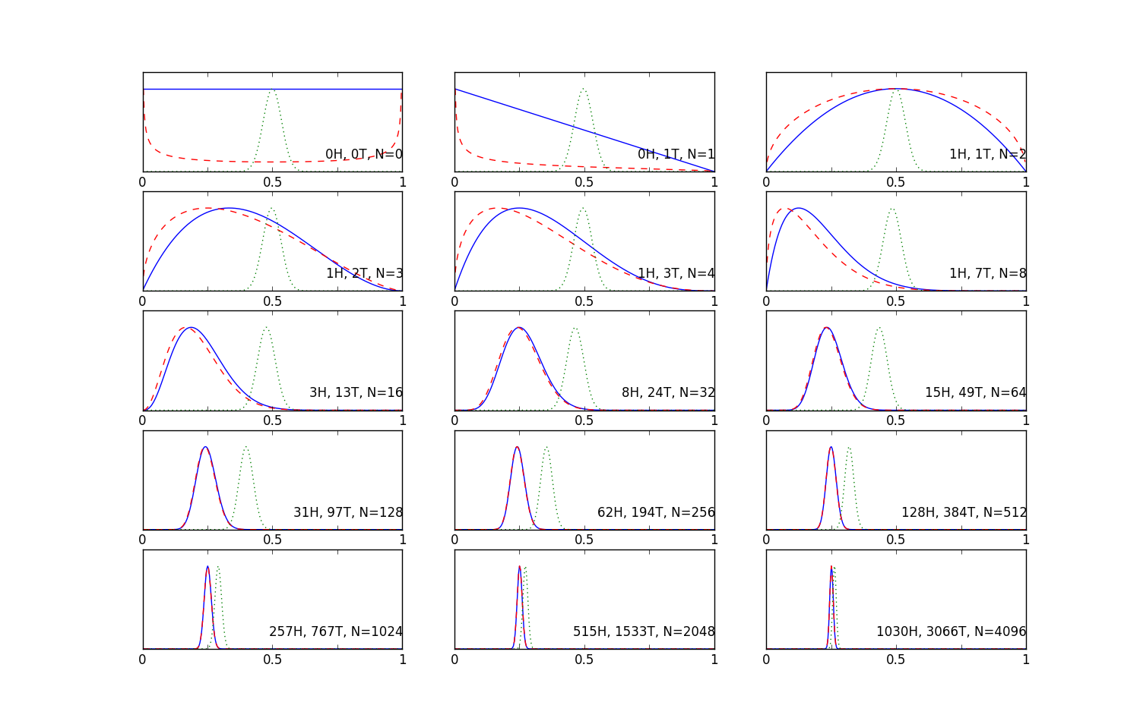
Posterior distribution using different priors.
Source : http://qingkaikong.blogspot.com

Slide 16
More Statistical details from the appendix
STATISTICAL METHODS FOR SECONDARY ANALYSES
Bayesian Version of a Comparison of Proportions
Proportions are assigned uniform prior distributions; resulting posterior distributions follow beta distributions. Comparison between proportions in two treatment groups is thus a difference of two beta distributions. This is computed with sampling-based methods or, with large sample sizes, using a normal approximation to the beta distribution.
Bayesian Version of a t-test
When Y follows a Normal(μ,σ2) distribution, and a uniform prior distribution is assigned to (μ, log(σ)), the posterior distribution of μ is a scaled t distribution. Comparison between means in two treatment groups is thus a difference of two scaled t distributions. This is computed with sampling-based methods.

Slide 17
Bayesisian or not?
Different Interpretation of the results
Updating knowledge instead of testing a null hypothesis over and over again
Smaller sample size May be required but the smaller sample size, the bigger influence of the prior specification
  Lee S-Y, Song X-Y. Evaluation of the Bayesian and maximum likelihood approaches in analyzing structural equation models with small sample sizes. Multivariate Behavioral Research. 2004;39:653–686
Better handling of non-normal p1-p2s
  Eg, estimating a mediation effect
Still require assumption on prior probabilities
  Usually uniform and normal distribution are used. How to justify this specification?
Intensive computation time(WinBUGs)
In principal, Non-Bayesianist(Frequentist) can not agree on the assumption that the true p1-p2 is not a fixed number. Eg, The true incidence rate comparing the two groups follows the uniform distribution (-0.05, + 0.05)

Slide 18
References
Van de Schoot R, Kaplan D, Denissen J, Asendorpf JB, Neyer FJ, van Aken MA. A Gentle Introduction to Bayesian Analysis: Applications to Developmental Research. Child Development. 2014;85(3):842-860. doi:10.1111/cdev.12169.

