Slide 1

Biostatistics Case Studies 2017
Genetic Study of Common Diseases: Genome Wide Association Study, Meta-analysis, Trans-Ethnic Study, Clinical and Biological Relevance of GWAS Loci
Xiuqing Guo, Ph.D
Director of Mathematical and Statistical Genetics
Institute for Translational Genomics and Population Sciences LABioMed at Harbor-UCLA

Slide 2
Goals of Common Diseases Genetics
Better understand disease pathogenesis
Identify high risk population
Develop specific preventive and therapeutic measures
Apply individualized medicine

Slide 3
History of Gene Finding Efforts in Common Disease Genetics
Blood group markers, serum enzyme polymorphisms, HLA
Restriction fragment length polymorphisms
Microsatellites (CA) reports
  1, 2, & 3 led to family based linkage studies
Single nucleotide polymorphisms (SNP’s)
Genome-wide association (lots of SNP’s)
Exome sequencing
Exome chip
Genome wide sequencing

Slide 4

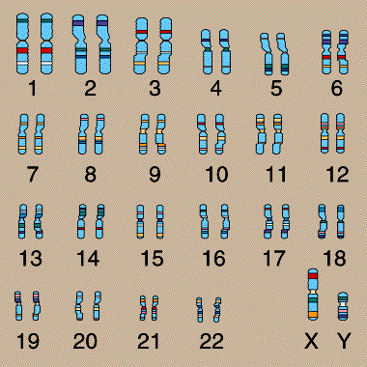
How Do You Know Where to Look?

Slide 5
How Do You Know Where to Look?
Look “Genome-wide”

Slide 6
What is GWA?
Genome Wide Association – A way of looking at the entire genome at one time with fine resolution, VERY fast
Technology makes it possible to genotype 700,000 to 2,500,000 SNPs per subject at 100 to $175 US
Computer methods to analyze a dataset of this size have become available

Slide 7
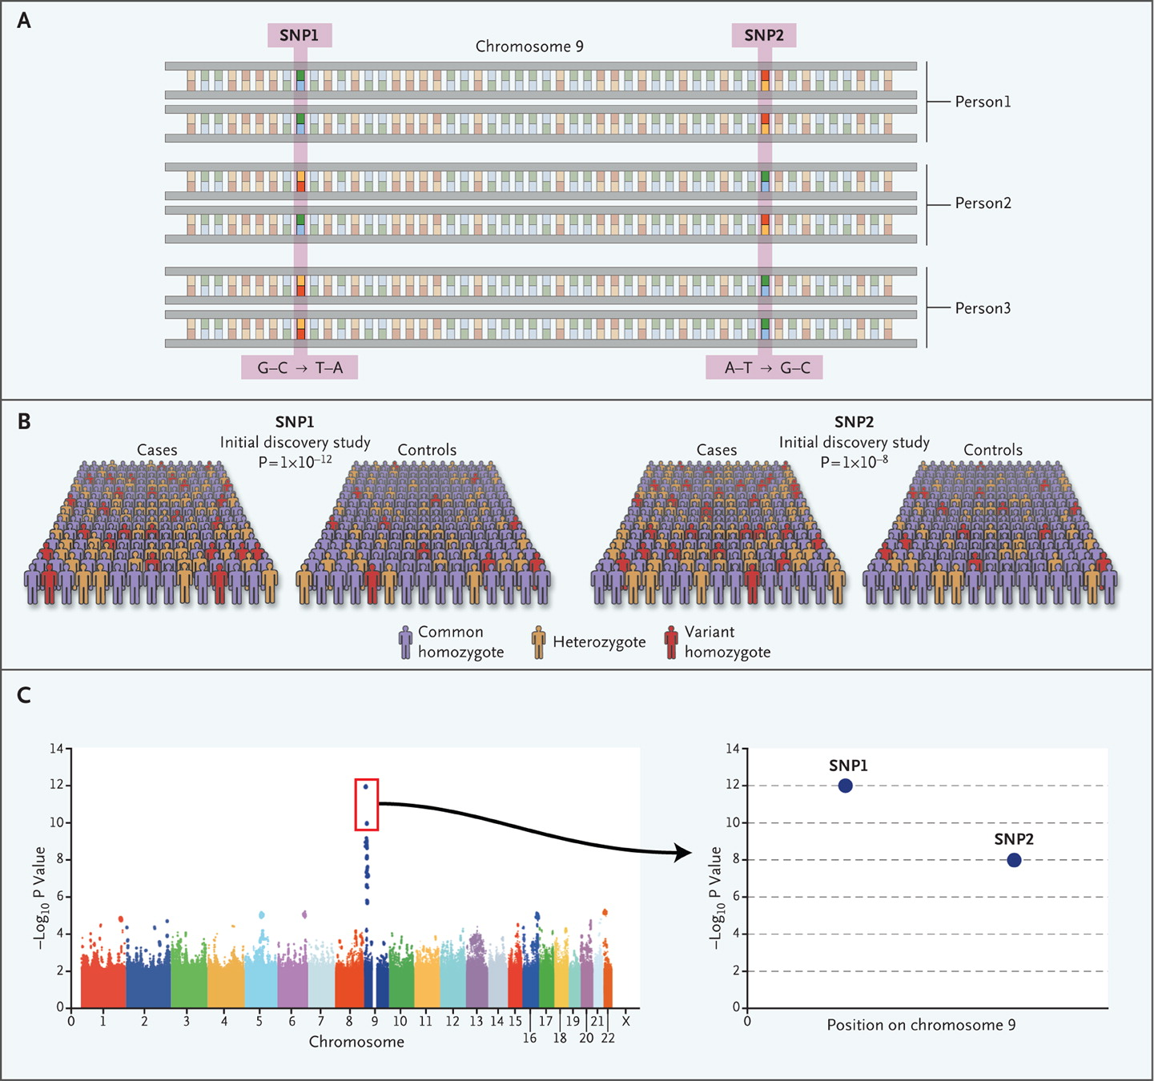
The Genome-wide Association Study.
Manolio TA. N Engl J Med 2010;363:166-176.
Notes:
Figure 1. The Genomewide Association Study. The genomewide association study is typically based on a case–control design in which single-nucleotide polymorphisms (SNPs) across the human genome are genotyped. Panel A depicts a small locus on chromosome 9, and thus a very small fragment of the genome. In Panel B, the strength of association between each SNP and disease is calculated on the basis of the prevalence of each SNP in cases and controls. In this example, SNPs 1 and 2 on chromosome 9 are associated with disease, with P values of 10⁻¹² and 10⁻⁸, respectively. The plot in Panel C shows the P values for all genotyped SNPs that have survived a quality-control screen, with each chromosome shown in a different color. The results implicate a locus on chromosome 9, marked by SNPs 1 and 2, which are adjacent to each other (graph at right), and other neighboring SNPs.

Slide 8
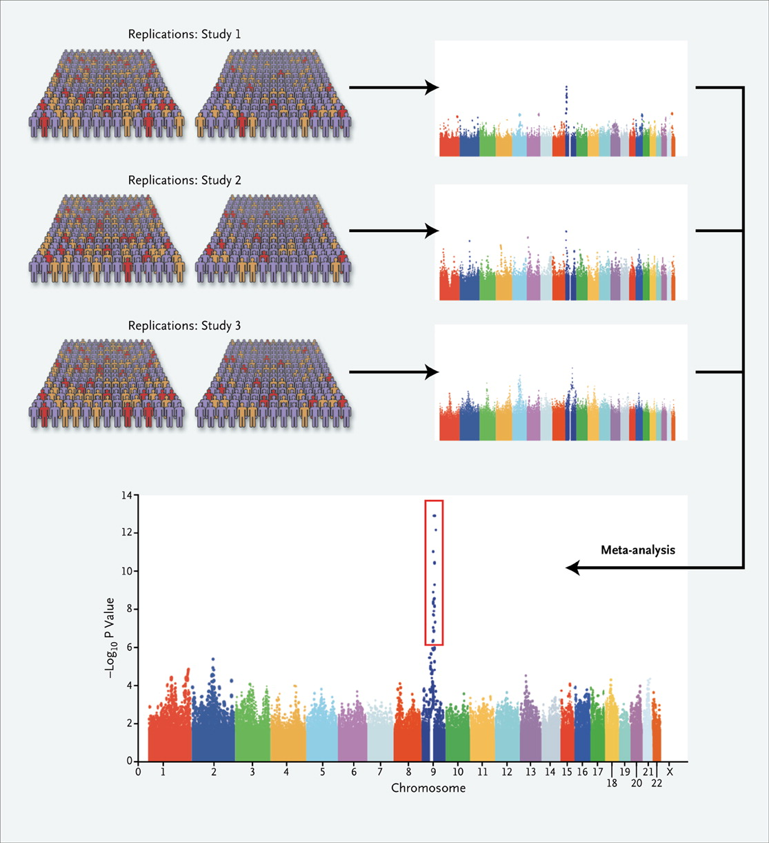
Meta-Analysis of Genome-wide Association Studies.
Manolio TA. N Engl J Med 2010;363:166-176.
Notes:
Figure 2. Meta-Analysis of Genomewide Association Studies. The results of genomewide association studies can be evaluated in a meta-analysis, which combines the results of multiple studies to improve the power for detecting associations. In this example, the results of three studies, none of which may show genomewide significance individually, are combined in a meta-analysis to reveal a strong, significant signal on chromosome 9.

Slide 9
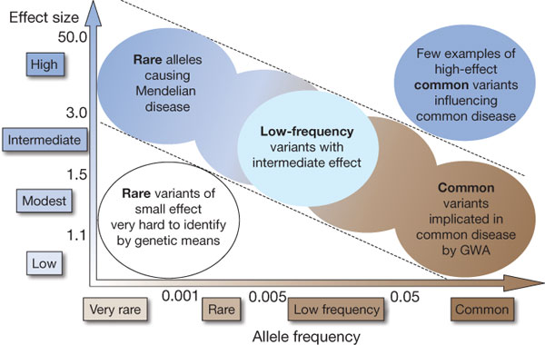
Goal: Define the genetic architecture of a complex genetic disease
Manolio et al., Nature 2009

Slide 10
Why study lipid levels?
Low-density lipoprotein cholesterol (LDL) levels are a treatable, heritable risk factor for heart disease, the leading cause of the death in the United States
High-density lipoprotein cholesterol (HDL) and triglyceride levels related to risks of cardiovascular and metabolic disease
Initially, much of the insights into lipid metabolism came from the study of rare Mendelian disorders of high and low LDL-C
Courtesy, C. Willer, 5/13

Slide 11
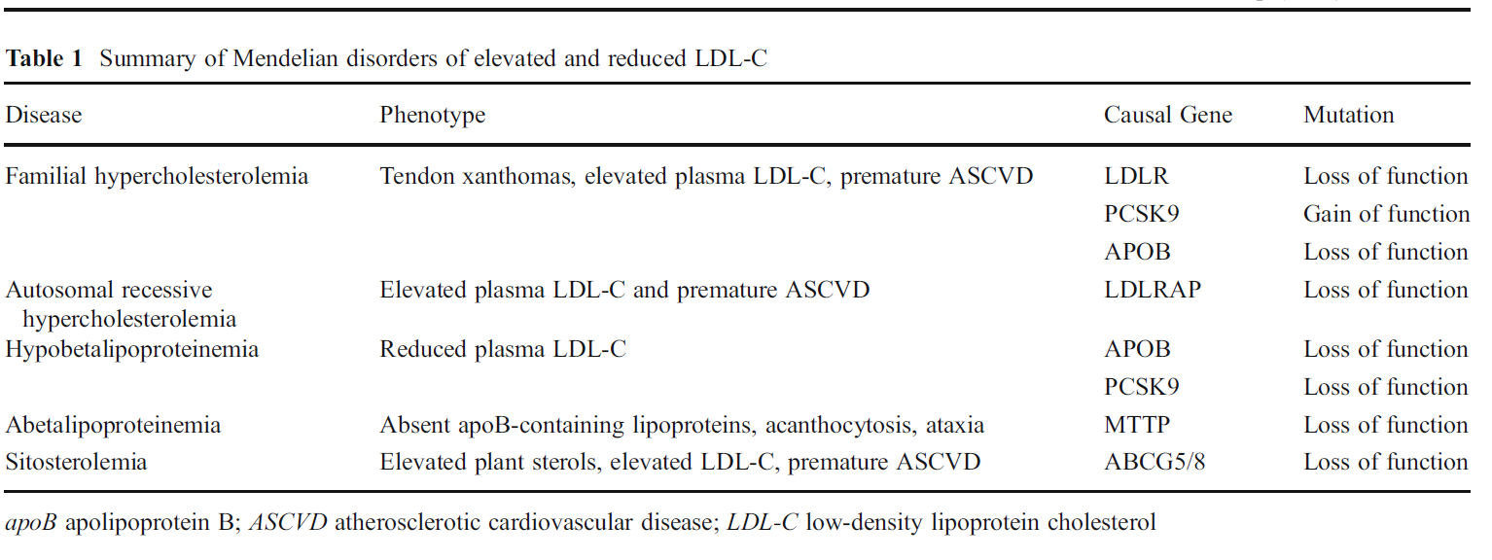
Strong & Rader, Curr Atheroscler Rep 14:211-218, 2012.

Slide 12
Genome-wide Approach to Lipid Variation

Slide 13
Genetic basis of lipid levels in the general population
GWAS have identified common variants that explain ~10-12% of variation in lipid levels (HDL cholesterol, LDL cholesterol, total cholesterol and triglyceride levels)
Common variants in GWAS framework
Rare variants identified from sequencing
Courtesy, C. Willer, 5/13

Slide 14
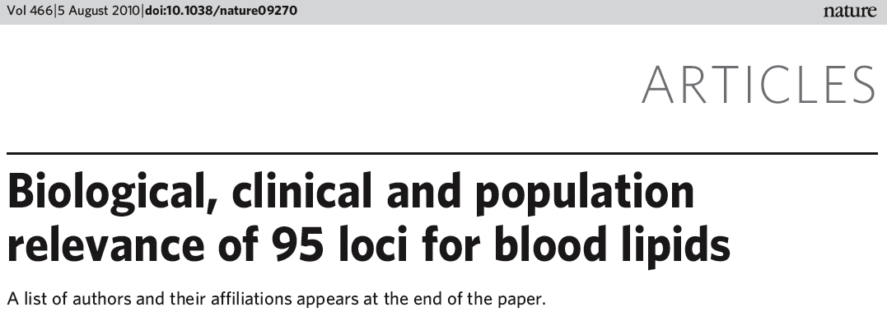
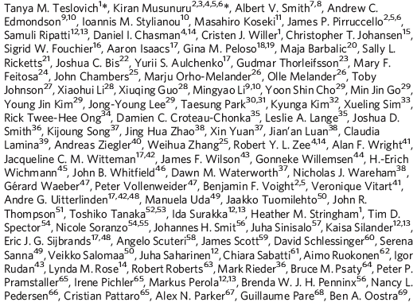


Slide 15
Study sample
46 participating studies in the discovery study, including
  Community-based cohorts
  Case-Control samples
  Family-based samples
  Replication study includes
    East Asian cohorts, South Asian cohorts, African American cohorts, as well as European cohorts

Slide 16
Genome-Wide Association Analysis
With each study
  Each genotyped or imputed SNP was tested for association with each of the lipid traits
  Linear regression was employed for unrelated individuals, and linear mixed effects models were used to account for family structure for family-base studies.
    trait ~ SNP + sex + age + age² + extra additional study specific covariates

Slide 17
Why Meta-analysis
Strength in numbers
  Several ‘non-significant’ differences may be significant when combined
Strength in diversity
  Generalizability across variety of participants, research method, measures, settings, ...
Good way to look at the forest rather than the trees

Slide 18
Meta-analysis
Ideas behind meta-analysis predate Glass’ work by several decades
  Karl Pearson (1904)
    averaged correlations for studies of the effectiveness of inoculation for typhoid fever
  R. A. Fisher (1944)
    “When a number of quite independent tests of significance have been made, it sometimes happens that although few or none can be claimed individually as significant, yet the aggregate gives an impression that the probabilities are on the whole lower than would often have been obtained by chance” (p. 99).

Slide 19
Meta-Analysis
Combines results from 2 or more studies
Estimates an ‘average’ or ‘common’ effect
  Simple average: weights all studies equally
  Weighted average: gives more weight to studies which gives more information, e.g. more sample, more events, narrow confident interval
  Inverse-variance method: weight = 1/variance of estimate
  Pooled estimate=sum(estimate x weight)/sum of weights

Slide 20
Meta-Analysis in Lipids GWAS
To combine association results across the 46 studies, we performed a fixed-effects meta-analysis using METAL for each of the four lipid traits.
For each SNP, in each study, a Z-statistic was calculated that summarized the magnitude and direction of effect relative to a randomly selected reference allele.
The overall Z-statistic was calculated from the weighted sum of the individual study statistics; weights were proportional to the square root of the sample size of each study and scaled so that squared weights summed to one.
Each study was subjected to genomic control correction before inclusion in the meta- analysis to account for P-value inflation due to residual population structure or other confounding factors.

Slide 21
Genetic Meta-Analysis Softwares
Meta: https://mathgen.stats.ox.ac.uk/genetics_software/meta/meta.html
METAL: http://genome.sph.umich.edu/wiki/METAL
MANTRA (Meta-ANalysis of Transethnic Association studies)

Slide 22
Latest GWAS for lipids: 95 loci
Lipids meta-
analysis
N~100,000
Teslovich*, Musunuru* Nature, 466:707-713, 2010
LDL-C | LDL-C | LDL-C | HDL-C | HDL-C | HDL-C | HDL-C | TG | TG
PP1R3B | PCSK9 | YSK4 | ANGPTL4 | LRP | LCAT | COBLL1 | PINX1 | ANGPTL3
LDLR | CETP | GRINA | PP1R3B | RBMS | MLXIPL | GLUL | NAT2 | JMJDIC
MYLIP | FADS | ANXA9 | LDLR | APOE | PGS1 | BC017935 | CILP2 | MLXIPL
CILP2 | ANGPTL3 | TIMD4 | TTC39B | OR4C46 | CMIP | GALNT2 | LPL | AFF1
APOB | HRP | LPA | LPL | ARLIS | DR1 |  | APOB | APOA
DNAH11 | HMGCR | FN1 | UBE2L3 | CETP | SCG39A8 |  | GCKR | DNAH10
KIAA1305 | GFI1 | MOSC1 | PDE3A | LRP1 | ABCA1 |  | VKORC1 | TRIB1
LDLRAP1 | 1p13 | CR596412 | APOB | RPS3A | MVK |  | HLA locus | KLF14
HLA locus | GPAM |  | STARD3 | LIPC | 1p13 |  | FRMD5 | TIMD4
BRCA2 | APOA |  | C6orf106 | LILRA | APOA |  | PLTP | LPA
LPIN3 | TCF1 |  | MACF1 | LACTB | TRPS1 |  | APOE | COBLL1
ABCG5/8 | ST3GAL4 |  | HNF4A | FADS | SCARB1 |  | LRP1 | GALNT2
NPC1L1 | TRIB1 |  | PLTP | ABCG5/8 | TRIB1 |  | LIPC
APOE | ABO |  | LIPG | JMJDIC | KLF14 |  | FADS

Slide 23
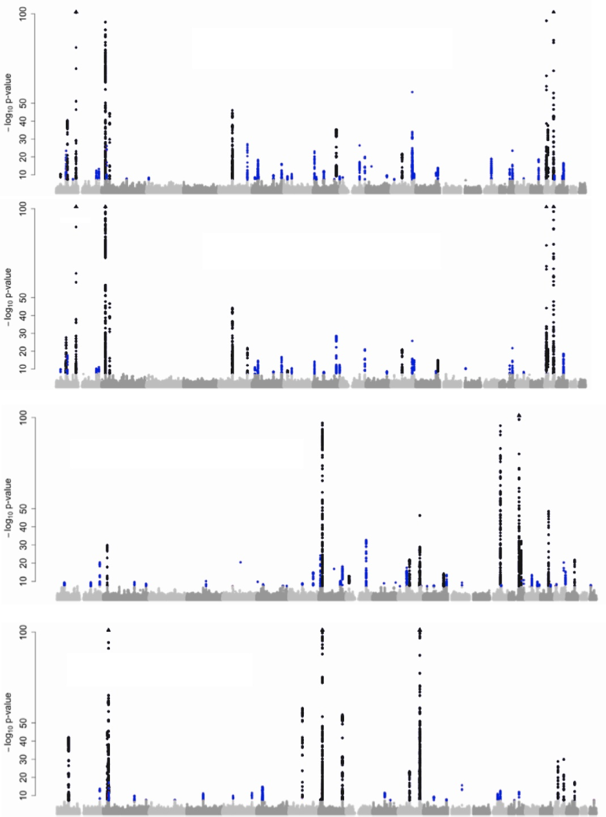
Genome-wide significant associations
Total Cholesterol
LDL Cholesterol
33 previously associated loci
62 loci not reported in previous GWAS
HDL Cholesterol
Triglycerides

Slide 24
Key questions
Do associated loci harbor genes of known biological significance?
Do common variants with modest effects combine to contribute to extreme phenotypes?
Are findings relevant more globally, or limited to the European population under study?
Notes:
24

Slide 25
1p13 is the top locus for LDL-C
(Global Lipids Consortium GWAS of 100,000 people)
Chr | SNP (genes) | Combined P value
1p13 | rs599839 (?????) | 8 x 10⁻¹⁶⁰
19p13 | rs4420638 (APOE) | 3 x 10⁻¹⁴⁰
19p13 | rs6511720 (LDLR) | 2 x 10⁻¹¹⁰
2p24 | rs1367117 (APOB) | 6 x 10⁻¹⁰⁹
2p21 | rs6544713 (ABCG5/ABCG8) | 4 x 10⁻⁴⁷
5q13 | rs12916 (HMGCR) | 1 x 10⁻⁴⁵

Slide 26
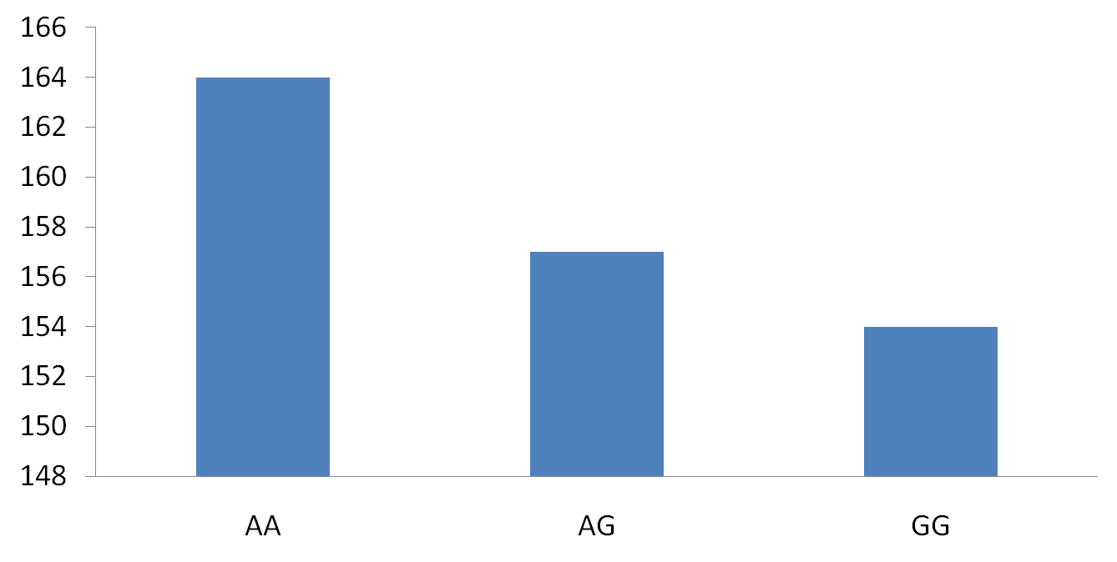
Minor allele homozygotes (4% population) have 16 mg/dL lower LDL-C
16 mg/dL
(0.41 mmol/L)
difference
P=1x10⁻¹⁴
N=2691
N=1771
N=296
Notes:
Among the most interesting of the new findings is 1p13. A SNP at this locus strongly affected LDL cholesterol, with a 16mg/dL across the homozygote classes
26

Slide 27

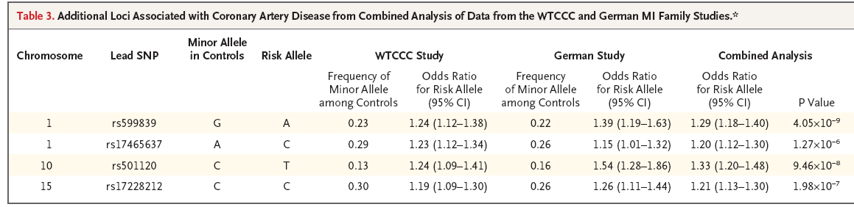
Minor allele homozygotes have 40% lower risk for coronary artery disease
GG Gentoype ⬇ 16mg/dL lower LDL ⬇ 40% lower risk
Notes:
The same SNP that we found related to LDL-C was recently reported by Samani et al to related to risk for coronary heart disease. In our study, we found that that individuals with the AA genotype had 16mg/dL increased LDL-C. And these individuals had a 1.3-fold increased risk for one copy and 1.7-fold increased risk with two copies.
27

Slide 28
1p13 is the top locus for LDL-C
(Global Lipids Consortium GWAS of 100,000 people)
Chr | SNP (genes) | Combined P value
1p13 | rs599839 (?????) | 8 x 10⁻¹⁶⁰
19p13 | rs4420638 (APOE) | 3 x 10⁻¹⁴⁰
19p13 | rs6511720 (LDLR) | 2 x 10⁻¹¹⁰
2p24 | rs1367117 (APOB) | 6 x 10⁻¹⁰⁹
2p21 | rs6544713 (ABCG5/ABCG8) | 4 x 10⁻⁴⁷
5q13 | rs12916 (HMGCR) | 1 x 10⁻⁴⁵

Slide 29
Known drug targets
Drug class | Effect on LDL | Gene target | MAF | Effect (mg/dl)
Statins | ↓ 40-60% | HMG-CoA Reductase (HMGCR) | .39 | −2.45
Ezetimibe | ↓ 10-20% | Niemann-Pick C1 Like 1 (NPC1L1) | .43 | −1.17
Effect sizes of common variants are not correlated with efficacy of drugs that target those genes
Notes:
29

Slide 30
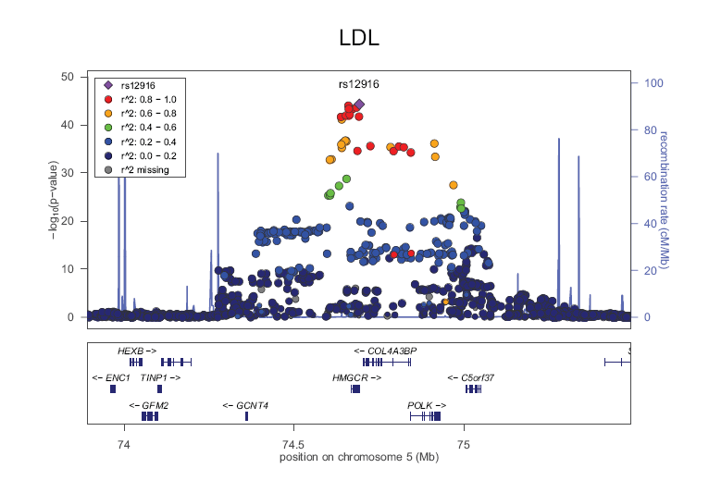
Loci of biological significance:
Known drug targets
HMG-CoA Reductase (HMGCR)
  Is the rate-limiting enzyme for cholesterol synthesis
  Statins, competitive inhibitors, ↑ expression of LDL receptors in the liver
  Atorvastatin or rosuvastatin reduce LDL-C by 40-60%
  Association with LDL p-value 10⁻⁴⁵
  Genetic variant has frequency 39%
  Effect of 2.45 mg/dl
Kathiresan*, Willer* et al. Nat Genet 2009

Slide 31
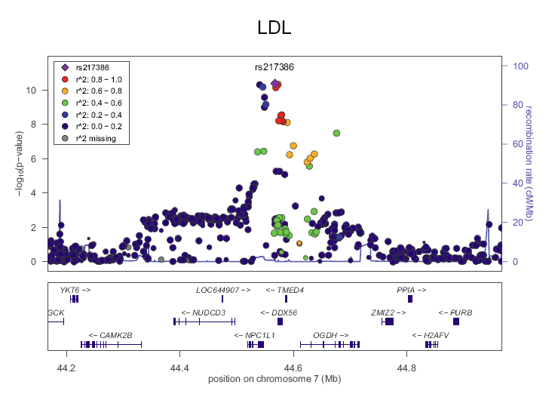
Loci of biological significance:
Known drug targets
Niemann-Pick C1 Like 1 (NPC1L1)
  Transporter expressed in epithelial cells in gastrointestinal tract and hepatocytes, involved in cholesterol absorption
  Target of Ezetimibe which reduces LDL-C by 18%
Association with LDL-C
10
Recombination rate (cM/Mb)
–log₁₀(p-value)
  Gene variant associated with LDL-C, frequency 42%, effect 1.17 mg/dl

Slide 32
Key questions
Do associated loci harbor genes of known biological significance?
Do common variants with modest effects combine to contribute to extreme phenotypes?
Are findings relevant more globally, or limited to the European population under study?
Notes:
32

Slide 33
Genetic Risk Score
Genetic risk score is usually calculated to test accumulated effect
• | Each SNP was individually associated at a genome-wide level
• | Score = the number of risk alleles for each SNP, weighted by the effect size (in this case log of odds ratio from the original report)

Slide 34
Genetic Risk Score (GRS)
Σ
]
]
Genetic Risk Score
# risk alleles at risk locus
effect associated with risk allele (β)
Sum over all risk loci
Example:
SNP | Locus Name | β | Risk Allele | Allele 1 | Allele 2 | Total Risk
rs1333049 | CDNKN2BAS | 0.207 | C | C | C | 2*0.207 = 0.414
rs515135 | APOB | 0.075 | G | G | C | 1*0.075 = 0.075
rs9515203 | COL4A1/COL4A2 | 0.079 | T | A | A | 0*0.079 = 0
 |  |  |  | Genetic Risk Score: |  | = 0.489
Notes:
A genetic risk score is calculated by multiplying the number of risk alleles at a risk locus by the effect associated with the allele and summing the products across all risk loci.
For example: for a given individual we can look at three SNPS. AT the first SNP, we see that the risk allele is C, and the individual carries two C-alleles. The beta (or effect) is 0.207, so we multiple 0.207 x 2 and we have the risk at that SNP. We move on to the next SNP. The risk allele is G. The individual carries one G, so we mult the effect (0.075) x 1 and we have the risk at the second SNP. We go on to the next to see that the risk allele is T. We see that the individual does not carry any risk alleles, so we multiple the effect (0.079) x 0. We then sum the risk associated with each SNP for a total genetic risk score.
All DNA genetic risk variants needs only be assessed once per lifetime since one’s DNA does not change over one’s lifetime and neither do they vary with time, meals, drugs or gender. (Roberts R. A genetic basis for coronary artery disease. Trends Cardiovasc Med. 2015 Apr;25(3):171-8.)

Slide 35
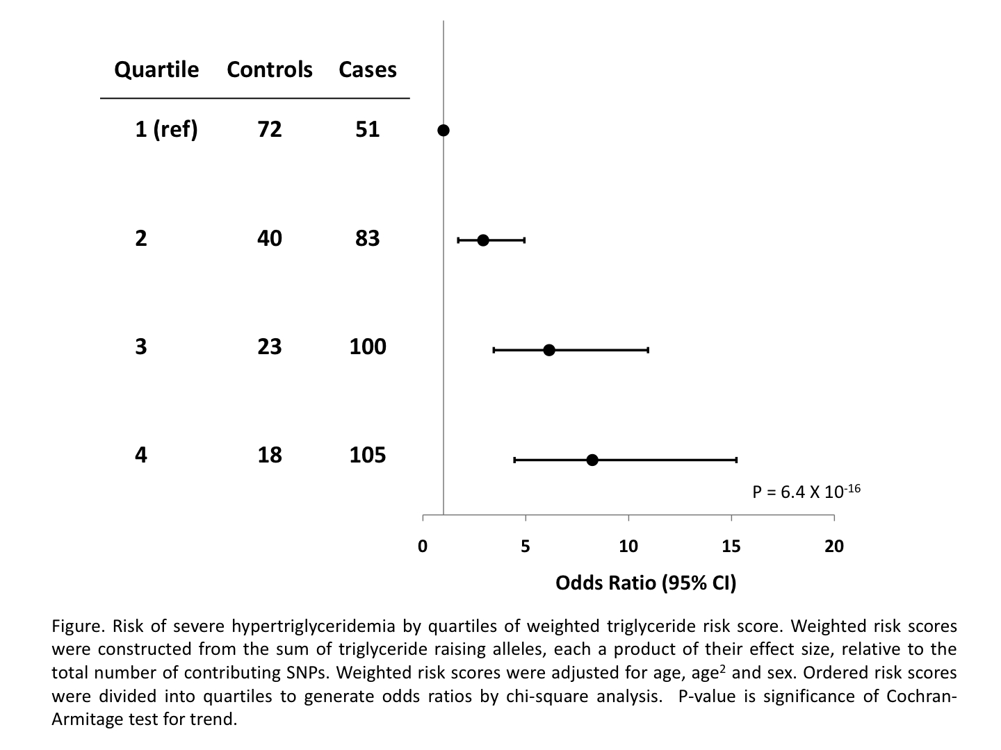
Cumulative effect of common variants is clinically important
Risk Score Quartile | Controls (low TG) | Cases (high TG)
1 (ref) | 47% | 15%
2 | 26% | 24%
3 | 15% | 30%
4 | 12% | 31%
Odds Ratio (95% CI)
P = 6.4 × 10⁻¹⁶
Similar findings for LDL and HDL
0
5
10
15
20
Notes:
35

Slide 36
Key questions
Do associated loci harbor genes of known biological significance?
Do common variants with modest effects combine to contribute to extreme phenotypes?
Are findings relevant more globally, or limited to the European population under study?
Notes:
36

Slide 37
Loci are relevant outside of Europe
Tested SNPs in 9700 Indian Asian samples
Similar findings in Korean and Chinese samples
Trait | # of SNPs with effect in same direction | binomial p-value
Total Cholesterol | 43 of 47 | 3 × 10⁻⁹
HDL Cholesterol | 37 of 41 | 1 × 10⁻⁷
LDL Cholesterol | 28 of 32 | 2 × 10⁻⁵
Triglycerides | 27 of 29 | 2 × 10⁻⁶
Notes:
37

Slide 38
Genetic Meta-Analysis Softwares
Meta: https://mathgen.stats.ox.ac.uk/genetics_software/meta/meta.html
METAL: http://genome.sph.umich.edu/wiki/METAL
MANTRA (Meta-ANalysis of Transethnic Association studies)

Slide 39
Questions?

